Slide 1
Introduction

Slide 2
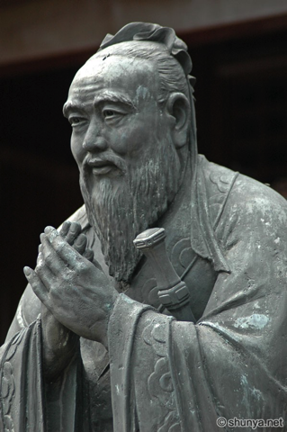
Confucius
It does not matter how slowly you go so long as you do not stop.
Our greatest glory is not in never falling, but in rising every time we fall.
I hear and I forget. I see and I remember. I do and I understand.

Slide 3
Essential Question
How can too high or too low of a population affect an economy?
NOTE: DO NOT WRITE THE PARTS WRITTEN IN ITALICS. THEY ARE JUST FUN FACTS!

Slide 4
Vocabulary
Communism: political and economic system in which the government controls many aspects of life.
Capitalism: economic system where the consumer (buyer) controls the market place (what is being bought and sold).
Empire: a group of states unified under a supreme leader, an emperor.
Buddhism: Religion based off of the first Buddha, Prince Siddhartha.
Confucianism: Religion based off of the teachings of Confucius.

Slide 5
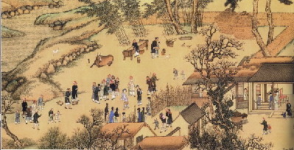
History

Slide 6
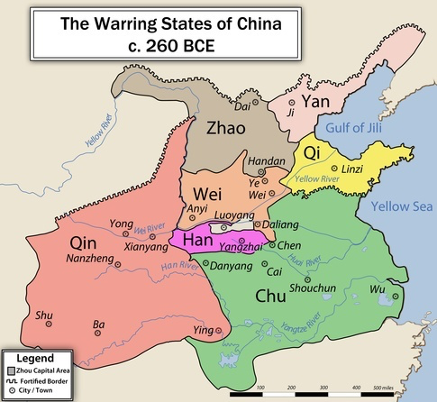
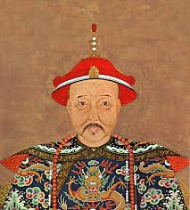
Emperors
China possesses one of the world’s oldest civilizations. For thousands of years, China was ruled by principalities and emperors.

Slide 7
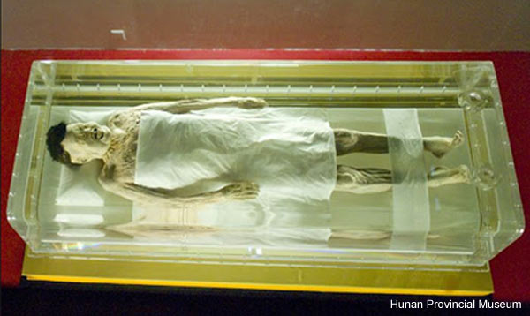
Emperors
Lady Dai, the name given to one of China’s most well preserved mummies, has helped historians and scientists get a glimpse of what life was like in Ancient China. She was so well preserved, that her skin is still elastic and her joints bend, like she is still alive! The noble lady died of heart disease, which was a surprise.

Slide 8
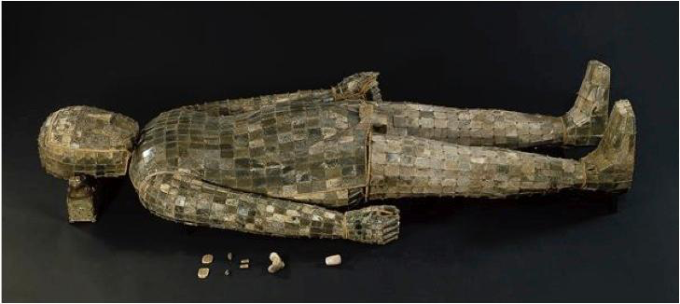
Emperors
Jade was believed to have a magical quality, granting those who wore it immortality and unnatural preservation of the body. Some emperors, those wealthy enough to afford it, were buried in jade suits.

Slide 9
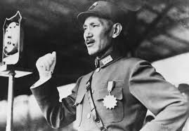
Modern History
During the early years of the 1900s, China attempted to become a republic under a party called the NATIONALISTS.

Slide 10
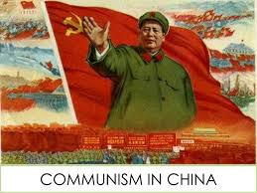
Modern History
Despite the Nationalists protests, in 1949 the communists came to power, led by Mao Zedong.

Slide 11
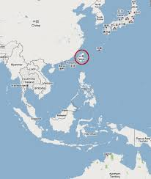
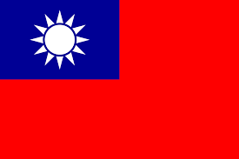
Modern History
After Mao, the Nationalists fled to Taiwan, which is officially called the REPUBLIC OF CHINA

Slide 12
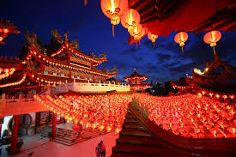
China Today

Slide 13
China’s official name is the People’s Republic of China

Slide 14
China is the world’s most populous country.

Slide 16
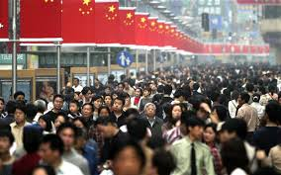
To slow population growth, China has used the One Child Policy
This has recently been modified to two children

Slide 17
Communism
Is the government control of resources and many aspects of society.

Slide 18
Communism
The government censors the press, the Internet, print publications, and academic research, and justifies human rights abuses as necessary to preserve “social stability.” It carries out involuntary population relocation and rehousing on a massive scale, and enforces highly repressive policies in ethnic minority areas in Tibet, Xinjiang, and Inner Mongolia. Though primary school enrollment and basic literacy rates are high, China’s education system discriminates against children and young people with disabilities. The government obstructs domestic and international scrutiny of its human rights record, insisting it is an attempt to destabilize the country.
China’s human rights activists often face imprisonment, detention, torture, commitment to psychiatric facilities, house arrest, and intimidation.

Slide 19
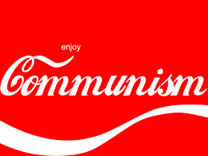
Economics
China has a MIXED economic system – in recent years, China has developed more capitalist ideas, allowing the consumer to have more choice.

Slide 20
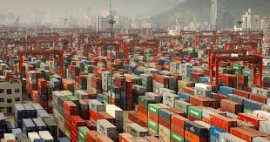
Global Trade
China is very involved in global trade, because labor is cheap. Workers in China make about $1/day.

Slide 21
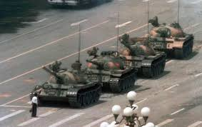
The lack of democracy and human rights are a concern.
Tiananmen Square was a protest put down by the government.

Slide 22
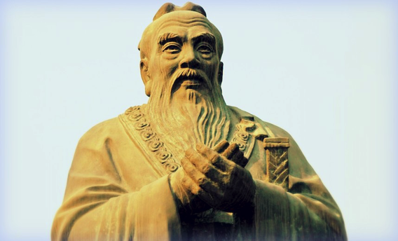
Religion
China is home to many religions, such as the indigenous Confucianism, Buddhism, Islam, and Christianity.
In China, party members cannot be Christian. More than half of China's Protestants attend illegal “house churches” that meet privately. The rest go to one of China's official, registered Protestant churches, such as Chongyi.

Slide 23
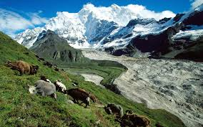
Tibet
Is a region of China that wants its independence, yet the Chinese government refuses to grant it.

Slide 24
That’s All!

